Slide 1














BLOCKCHAIN BASED E-VOTING SYSTEM
FINAL SEMINAR

Slide 2
SUPERVISORS
Dr. Dina Elsayad
TA. Manar Sultan

Slide 3
TEAM MEMBERS
Suhail Mahmoud
Heba Shaaban
Abdelrahman Hamdi
Rana Ahmed
Abdelrahman Osama
Habiba A. Abdulkader

Slide 4


AGENDA
01
02
03
04
05
Problem Definition
Motivation
Objective
System
Architecture
Data
Creation
06
07
08
09
10
Face Verification
ID Data
Extraction
Fake ID
Detection
Frontend
Blockchain
11
12
Conclusion
Future Work

Slide 5

01
PROBLEM DEFINITION

Slide 6
PROBLEM DEFINITION
Current voting systems face various security and transparency issues, including fraud, manipulation, and lack of trust from the public. Traditional systems make it challenging to securely identify voters while keeping their identities private. These vulnerabilities highlight the need for a reliable, decentralized solution to ensure vote integrity, transparency, and user privacy.

Slide 7
02
MOTIVATION

Slide 8
MOTIVATION
The main motivation is to build a secure and transparent e-voting platform that leverages blockchain's decentralized structure to provide an immutable record of votes. Additionally, it utilizes AI technology for user authentication, ensuring that only verified users can participate and that each vote remains anonymous and unaltered.

Slide 9
03
OBJECTIVES

Slide 10
OBJECTIVE
The main goal of this project is to develop an online voting system with blockchain as its core foundation and AI-powered identity verification. This system will :
Ensure privacy and trust in voting processes, benefiting governments, organizations, and private entities seeking secure voting solutions.
Enable real-time, auditable, and transparent voting records.

Slide 11
04
SYSTEM
ARCHITECTURE

Slide 12
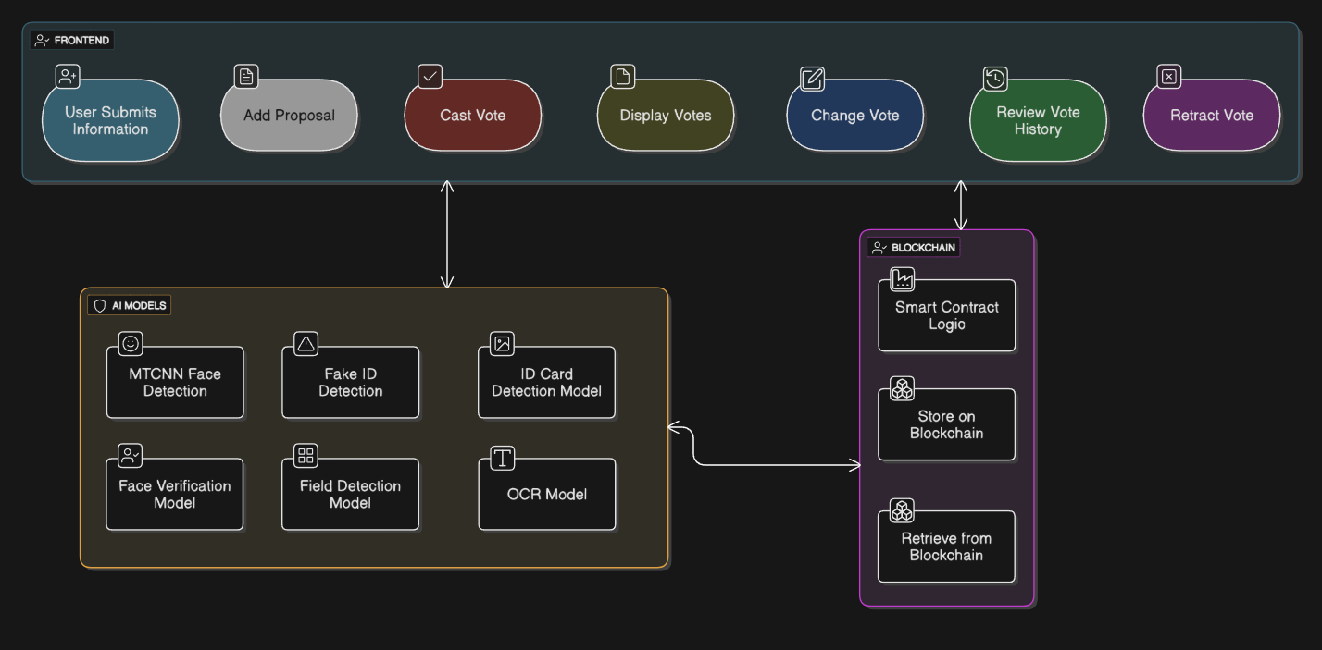
ENTIRE SYSTEM ARCHITECTURE

Slide 13
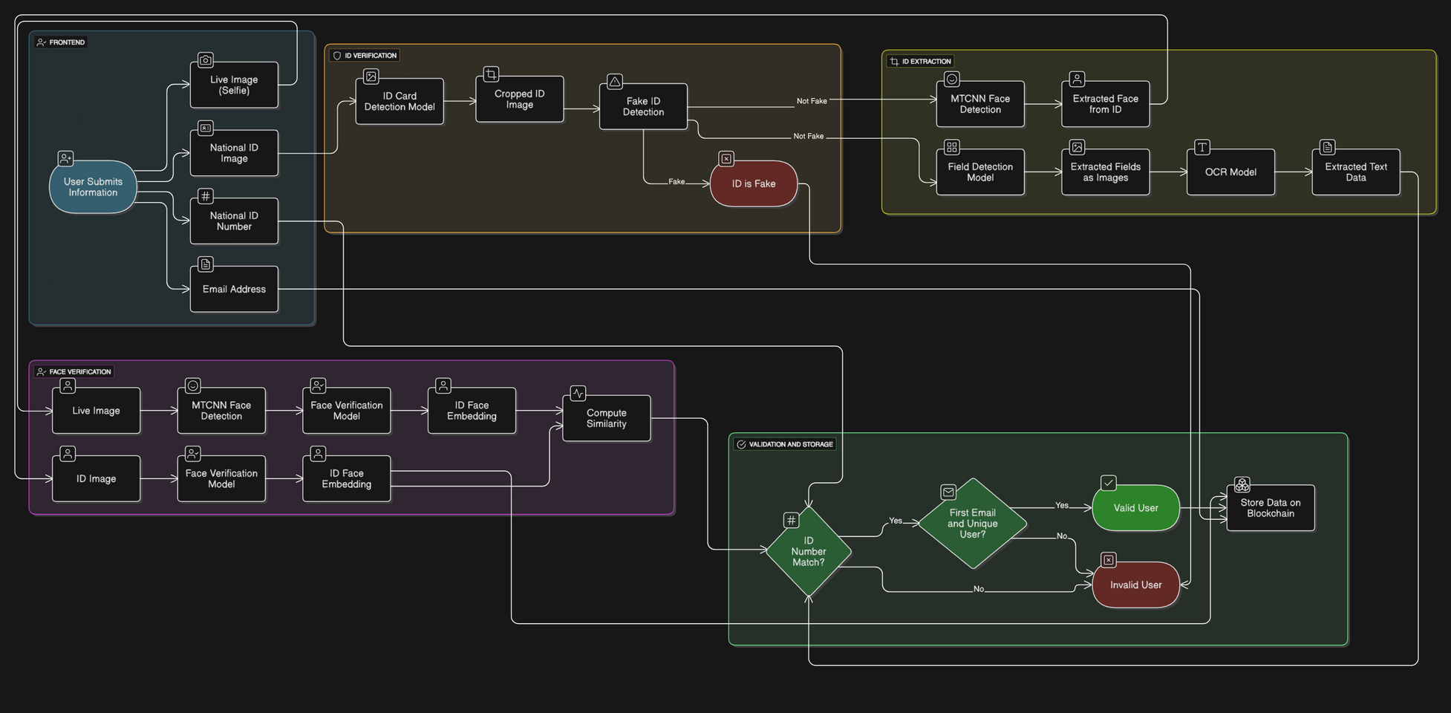
REGISTRATION PHASE FLOW

Slide 14
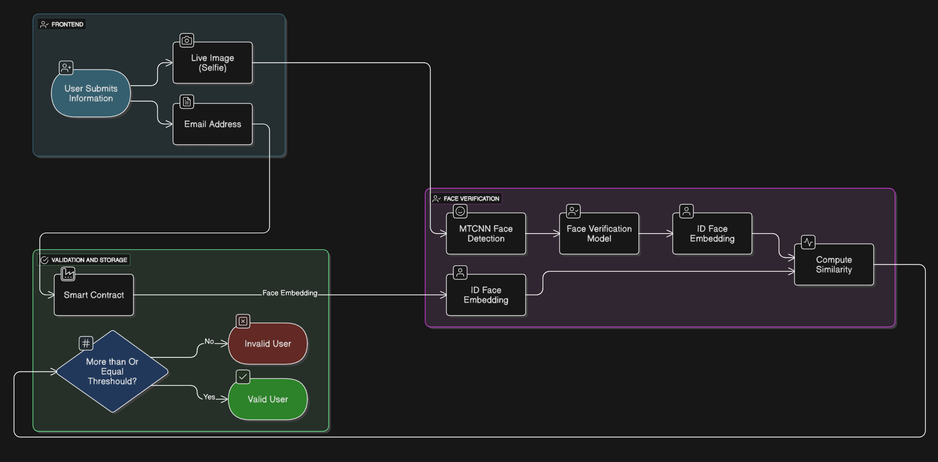
LOGIN PHASE FLOW

Slide 15
05
DATA
CREATION

Slide 16
DATA CREATION
We needed to collect and create Egyptian national ID Dataset.
Security: Verifying the user’s national id, we can prevent impersonation and unauthorized access.
Integration: AI verification integrates seamlessly with the blockchain to reduce administrative overhead.

Slide 17
DATA CREATION
Collecting all the data we can find, filtering to only keep Unique data
Websites (Roboflow, Facebook, google, github.....).
Number of Data over 32K image.
After filtering, only 8,649 image (probably).

Slide 18
DATA CREATION
Filtering
manually.
Using some regex technique for names of images.
Using CNN Network like Simple CNN Network MobileNetV2 with manual review.
Page 18

Slide 19
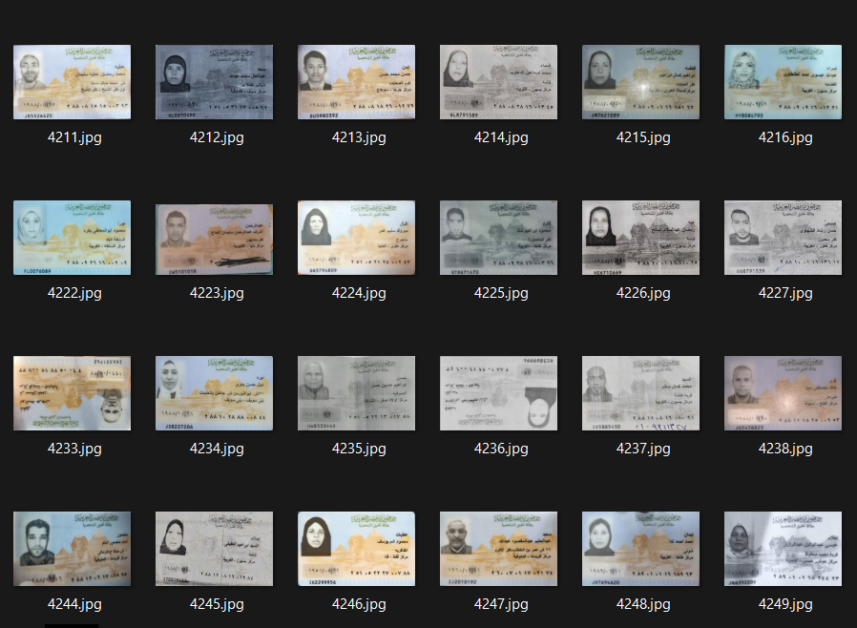

Slide 20
DATA CREATION
Unique Faces From
VggFace2 (8631 identity).
CelebA (10177 identity).
Synthetic Faces High Quality (SFHQ) part 4 (125K identity).

Slide 21
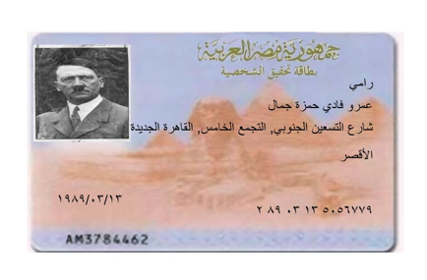
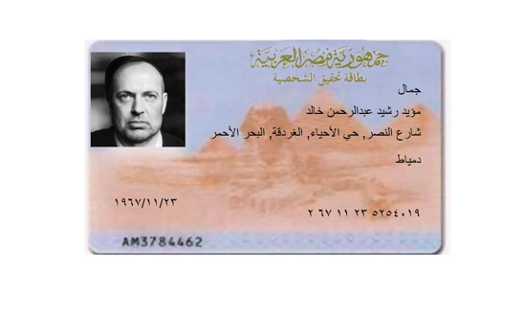
DATA CREATION

Slide 22
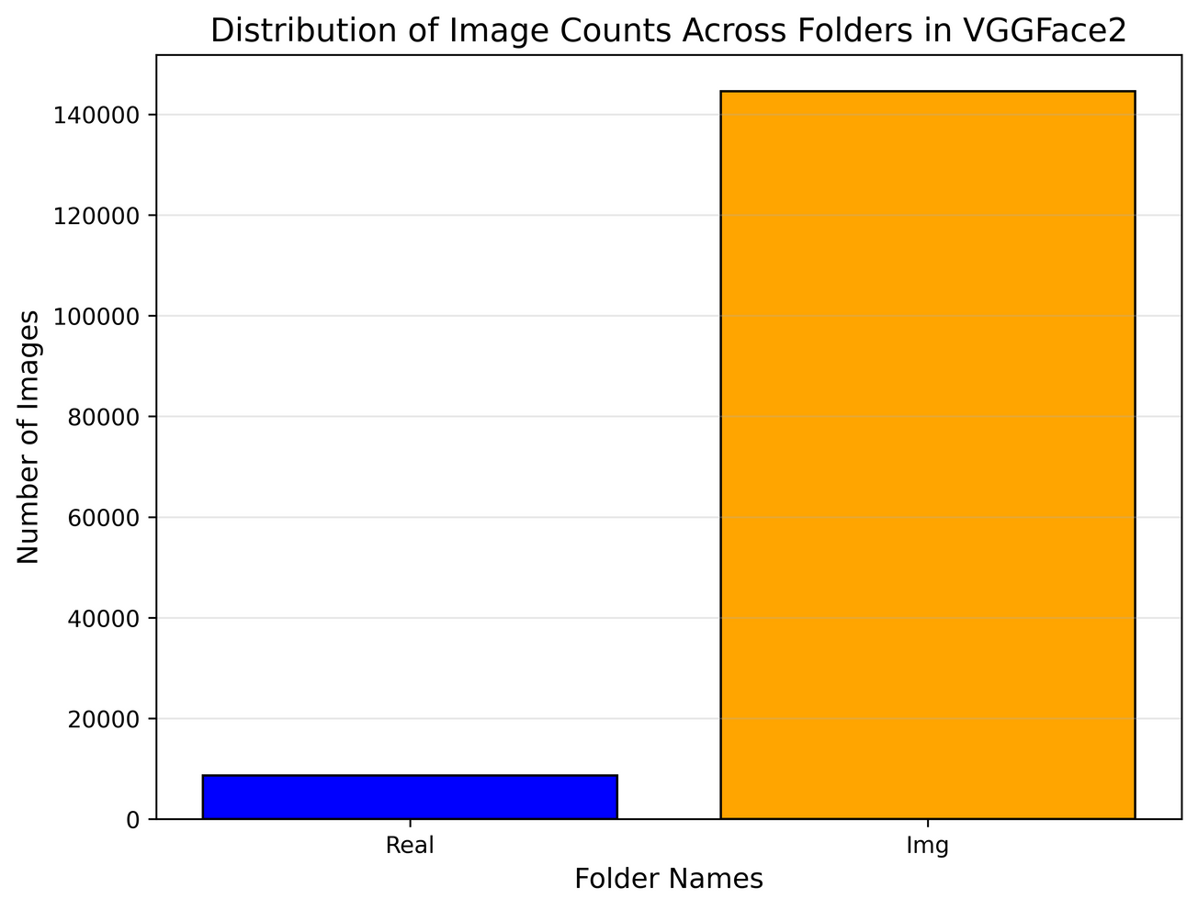
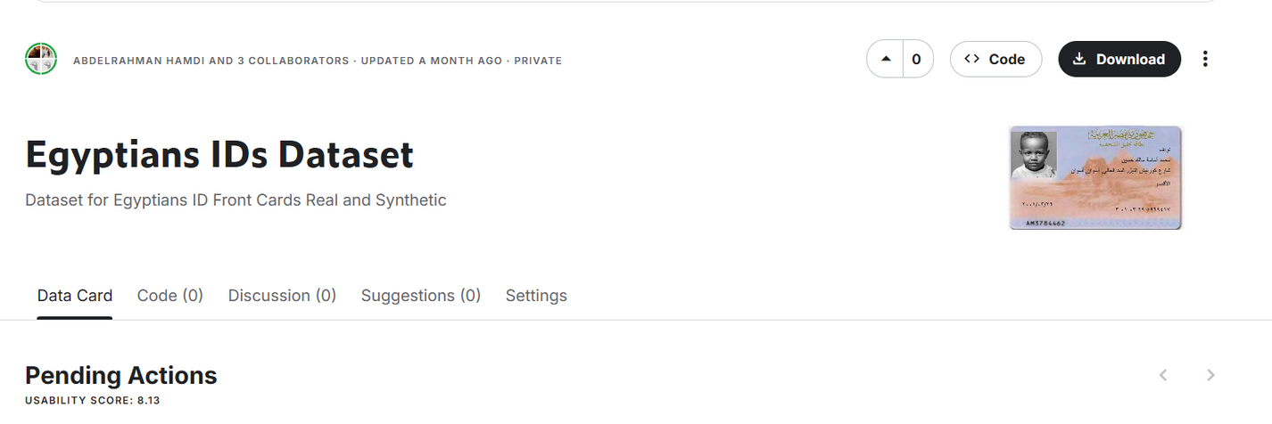
DATA CREATION
With 8649 real & over 144K Img,
Now, we had over 153K Egyptian ID Card.
it is now on Kaggle.

Slide 23

06
FACE
VERIFICATION

Slide 24
FACE VERIFICATION
WHAT IS THAT?
AI-based facial recognition module will ensure voter authentication.

Slide 25

Dataset: VGGFace2
Overview
Includes over 3.3 million images.
Contains over 9,000 identities.
Diversity in terms of pose, ethnicity, and lightning conditions.
Features
Pose Variation: Includes faces captured at various angles.
Expression Diversity: Includes images with a wide range of facial expressions.
Backgrounds: Includes images with varied backgrounds to improve generalization.

Slide 26
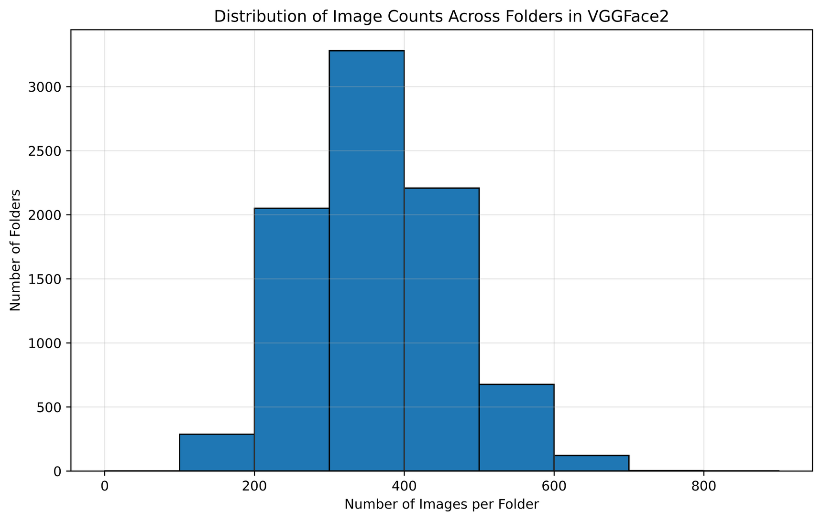
Analysis
Number of Identities: 8631
Number of Images: 3.14M
Min image per folder: 87
Max image per folder: 843
Avg images per folder: 364.02
Preprocessing
Detect Face (MTCNN)
Resize (160 x 160)
Augmentation (Horizontal Flip, Rotation, Color)

Slide 27
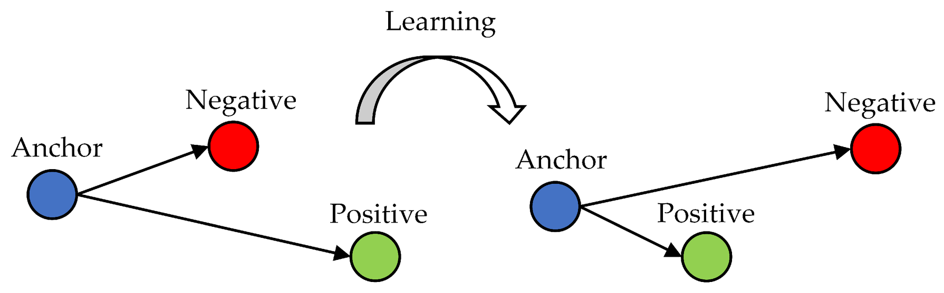
Triplets
Anchor , Positive from the Same Class and Negative from different Class
Model Learn to Increase distance between anchor and negative.
Decrease distance between anchor and positive.

Slide 28
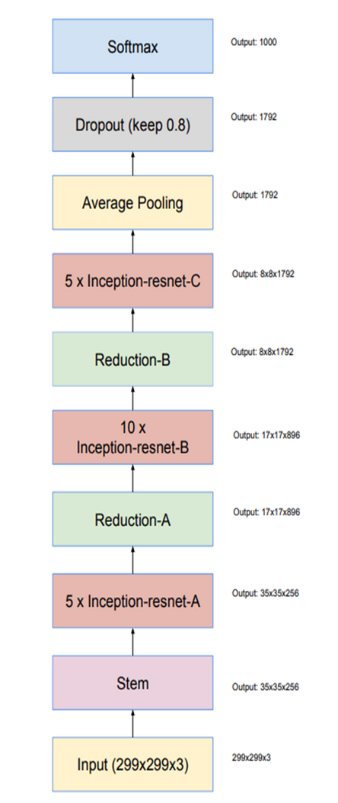
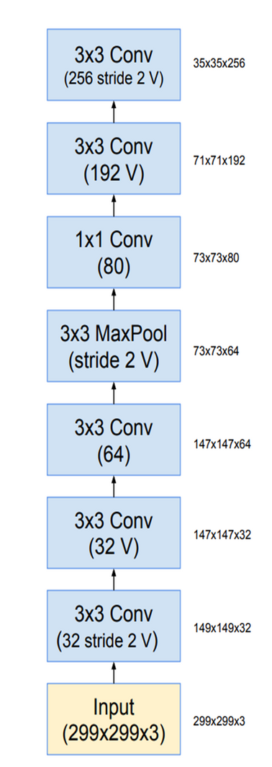
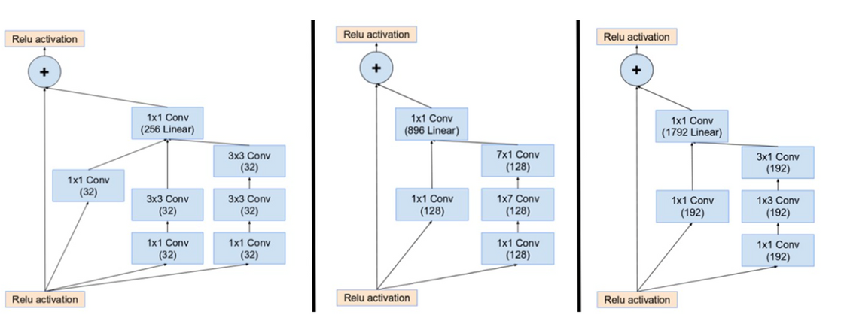
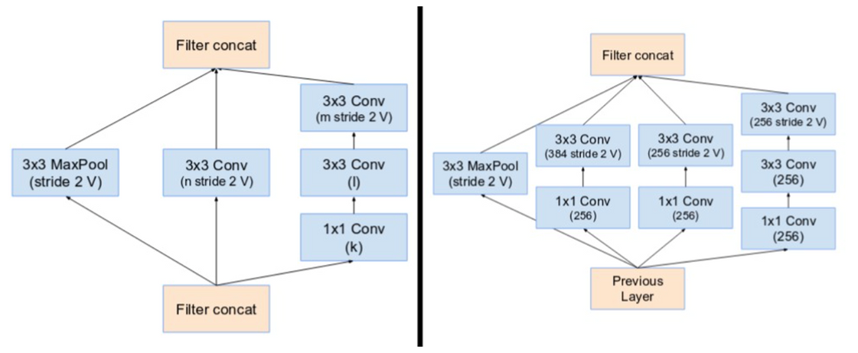
Model: InceptionResnet-V1

Slide 29
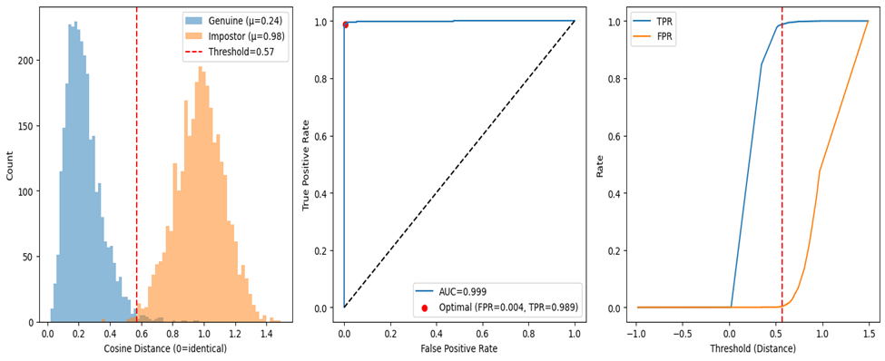
Result
Accuracy: 99.28%
Precision: 99.63%
Recall (TPR): 98.93%
F1-score: 99.28%
FPR: 0.37%
EER: 0.87%
Optimal Threshold: 0.5698
AUC: 0.999
Average Precision: 0.999

Slide 30


08
ID VERFICATION

Slide 31

ID VERIFICATION
ID Detection
model
Fields Detection
model
OCR
model

Slide 32
DataSet:
Dataset Name: Egyptian-ID-Dataset we have been collected from different resources
Usage Breakdown:
ID Detection: 4200 images to detect ID cards within larger images
(Fields Detection): 150 images to detect fields like Name, ID Number, Birthdate, etc.
Page 32

Slide 33
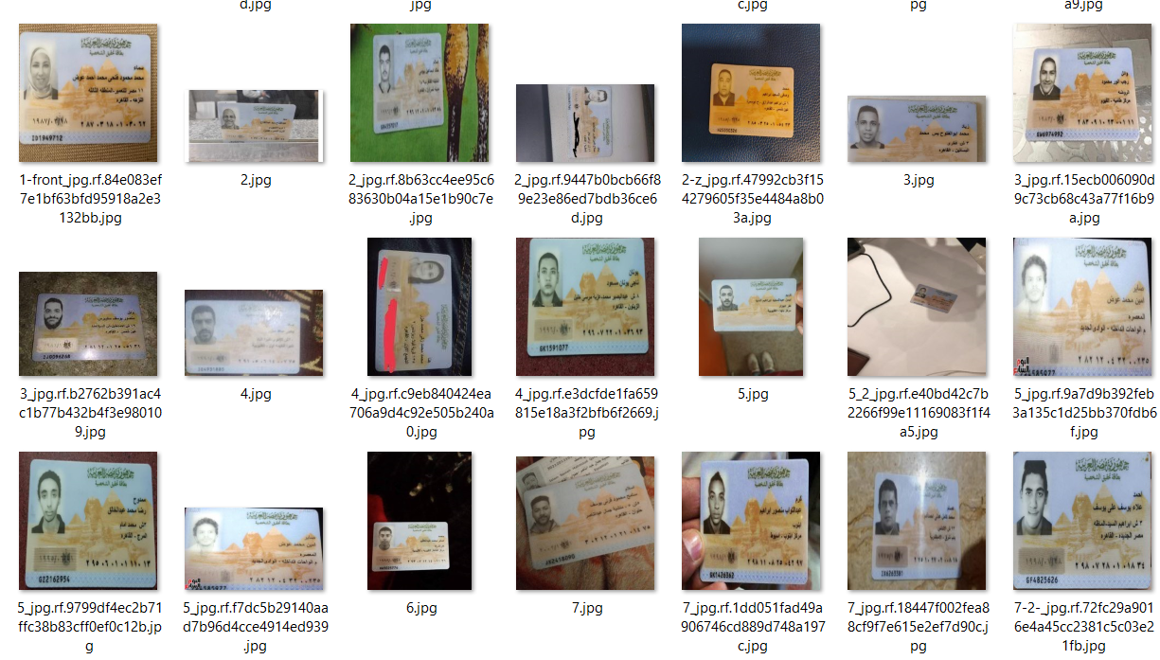
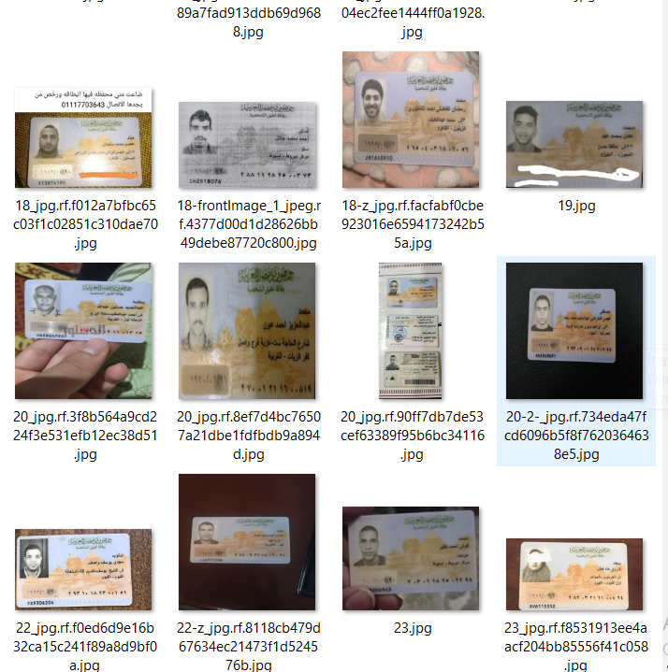
DataSet:

Slide 34
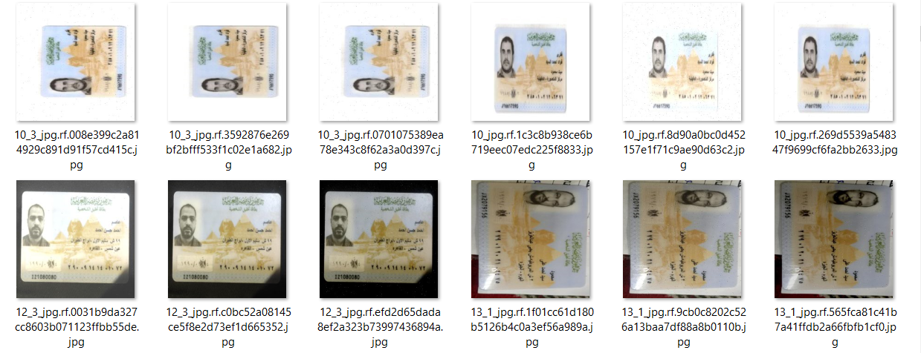
Preprocessing & Data Augmentation
Salt and paper noise , Brightness adjustment , Gaussian blur, Rotating

Slide 35
Dataset Overview & Usage
01
02
ID Detetction DataSet
(4200 image )
Fileds Detection DataSet
(150 image)
Page 35

Slide 36
Datasets Pipeline Using Roboflow
1. Labeling
2. Splitting
3. dataSet.yaml
(Exporting)
Roboflow made it easier to manage data and avoid bias during training
Page 36
Notes:
Labeling – We manually drew bounding boxes around the areas of interest, such as the ID card and the specific fields inside it.
Splitting – Roboflow automatically split our dataset into training, validation, and testing sets — usually 70% for training, 20% for validation, and 10% for testing.
Exporting (data.yaml) – Finally, we exported the dataset in YOLOv8 format. The data.yaml file defines the dataset structure, including paths and class names, which the model uses during training."

Slide 37
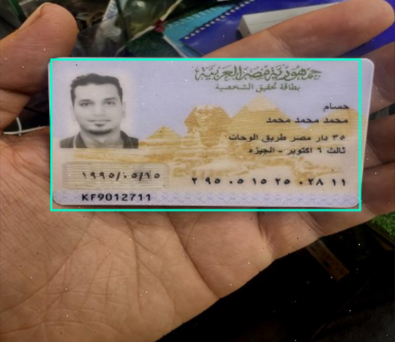
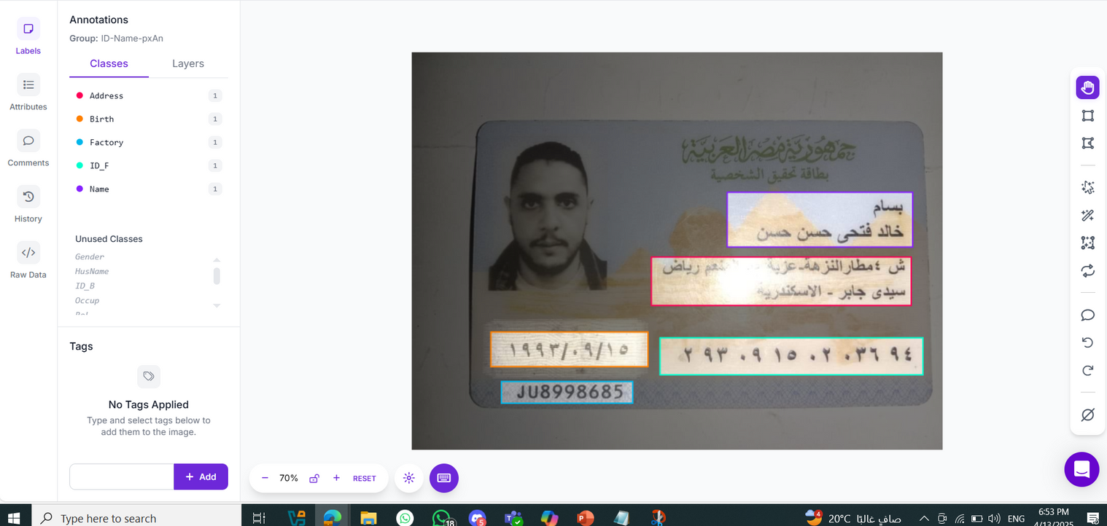
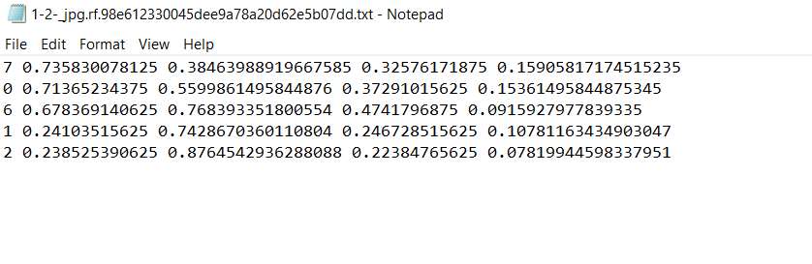
Labeling using Roboflow Tools
class_id ,x_center, y_center, width ,height
Page 37

Slide 38
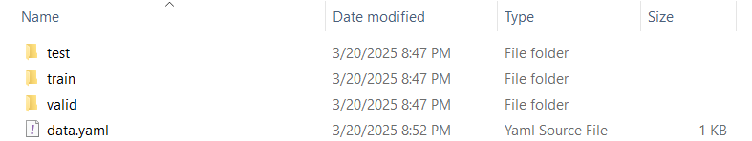
🗂️ splitting Dataset using YOLOv8 format
DataSet Splits into:
70% Training
20% Validation
10% Testing
Annotated via Roboflow
After collecting and labeling the dataset in Roboflow, we downloaded the YOLOv8-compatible format”
Data Set Strucure :
📂 train/
├── images/
└── labels/ ← Each .txt file contains bounding boxes for fields in the image
📂 valid/
📂 test/
📄 data.yaml ← Defines class names and paths

Slide 39

Let’s fine-tune our models

Slide 40

Model Selection
Why we Choose Yolov8 ?
We Used YOLOv8n.pt from Ultralytics
Because it’s Lightweight and fast
good for prototyping
Notes:
"We chose YOLOv8 for our object detection tasks because it offers excellent balance between accuracy, speed, and ease of use.
YOLOv8 is the latest and most advanced version in the YOLO family. It comes with:
Pretrained models that are easy to fine-tune on custom data
Strong performance in small object detection — which was perfect for detecting fields inside ID cards
And it supports exporting to many formats, making it easier to integrate with the rest of our system."
"Using YOLOv8 helped us reduce training time and achieve better results without the need to build a model from scratch."

Slide 41
Model 1: Detect ID Card inside image

Slide 42
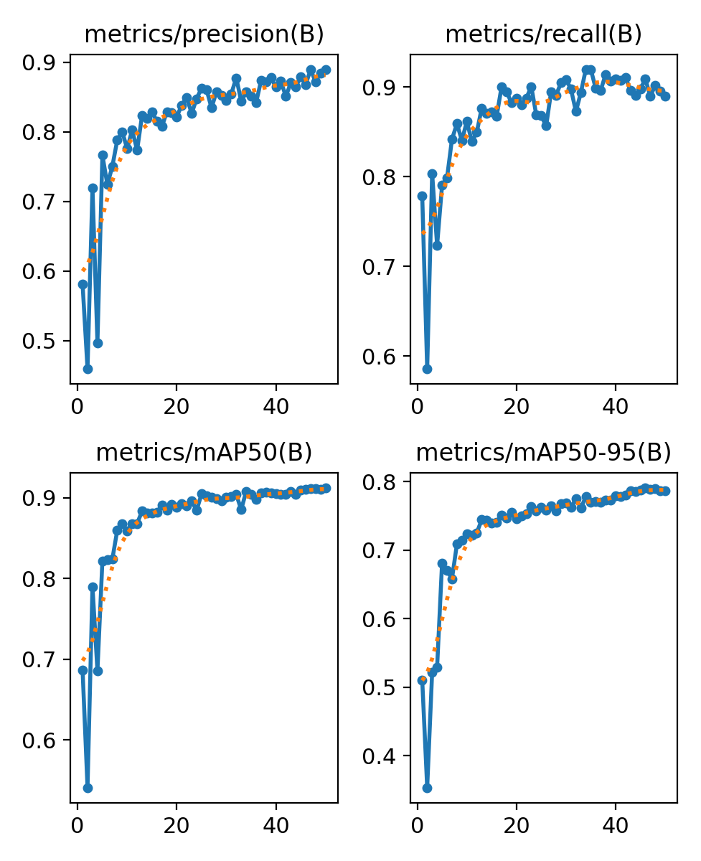
Model Performance
Started at 0.58 (epoch 1), reached 0.89 by epoch 50
Precision (B): 0.890
Recall (B): 0.890
mAP50 (B): 0.912 (IOU)
Page 42

Slide 43
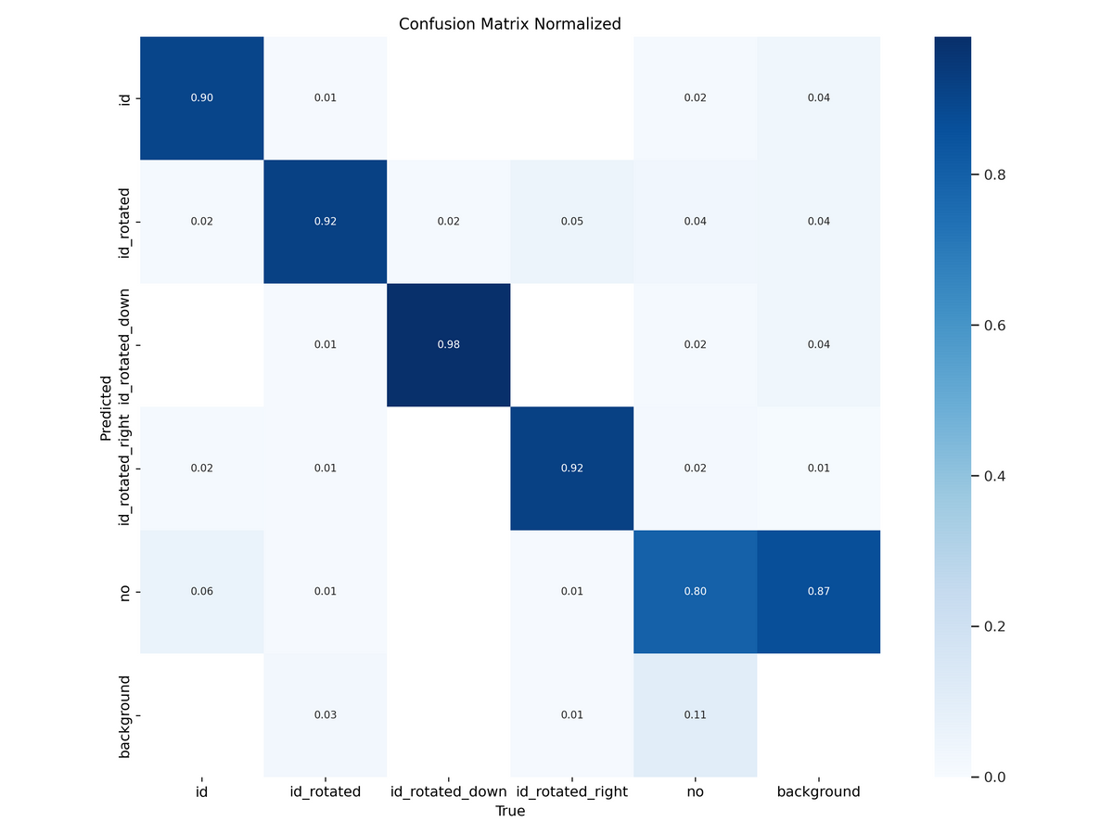
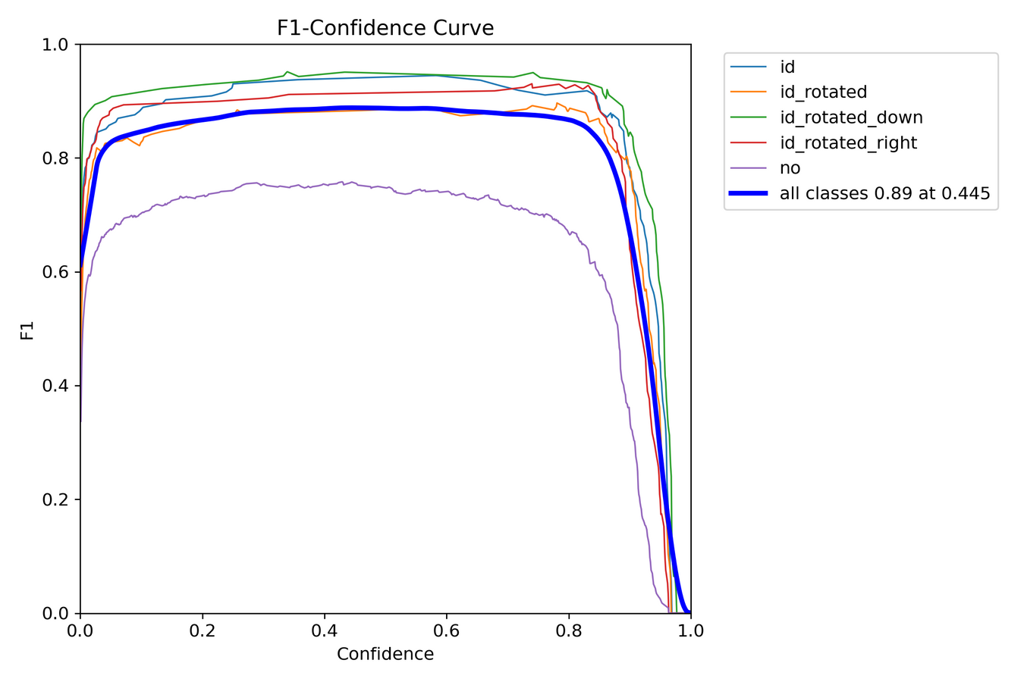
Confusion Matrix
F1-Curve

Slide 44
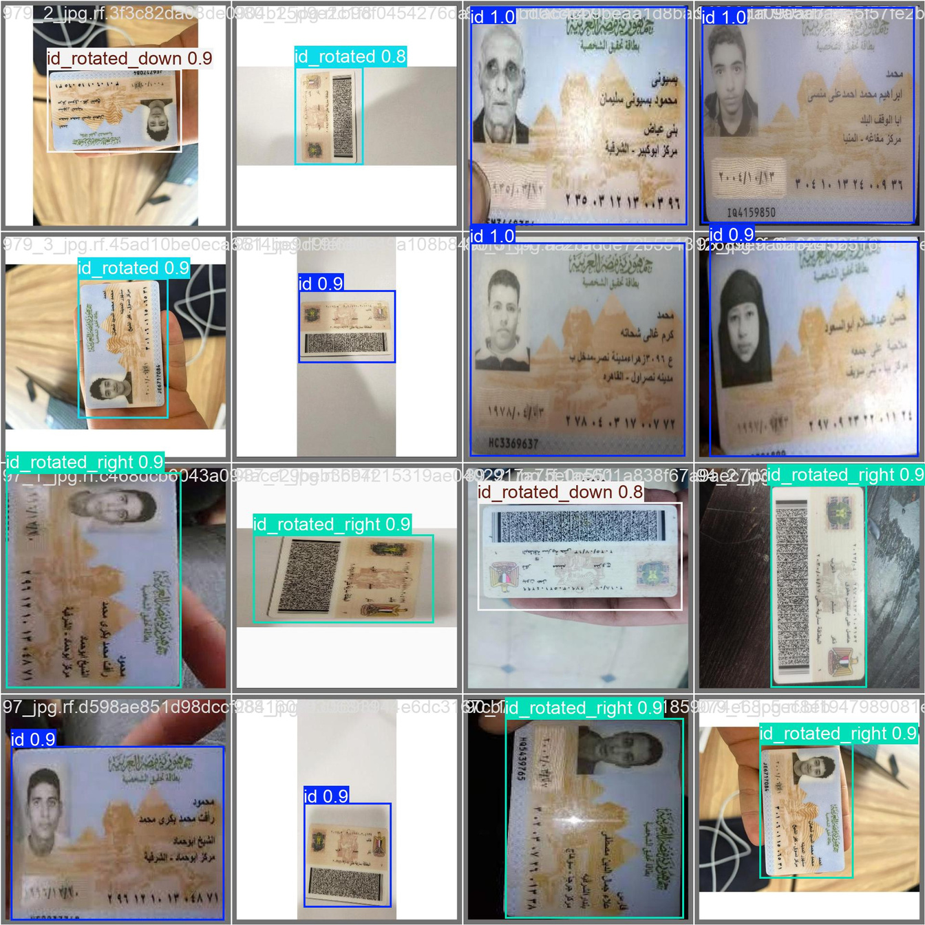
Predictions
id_rotated_down: 98%
id_rotated: 92%
id: 90%
id_rotated_right: 92%

Slide 45
Model 2: Detect Feilds inside ID Card

Slide 46
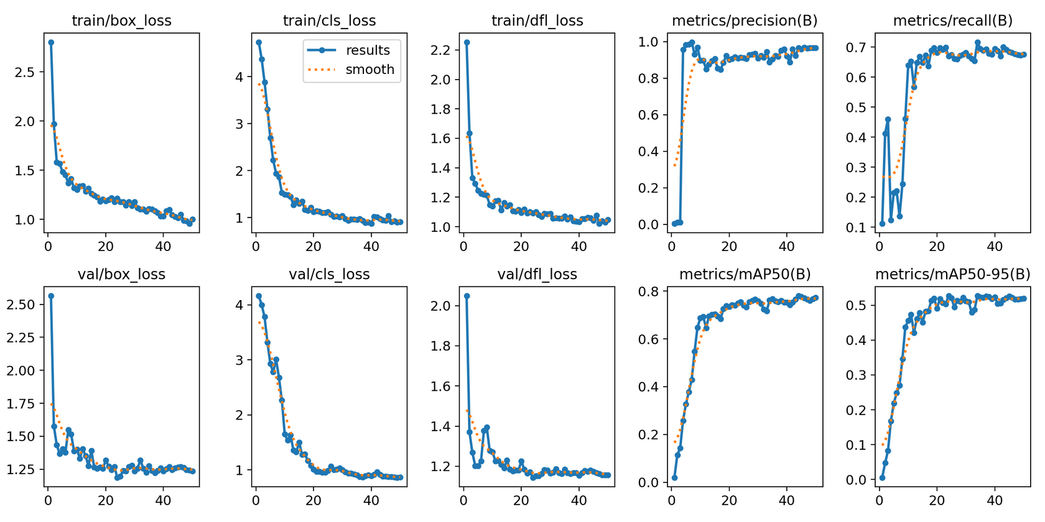
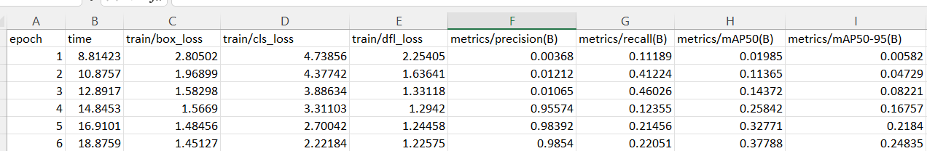
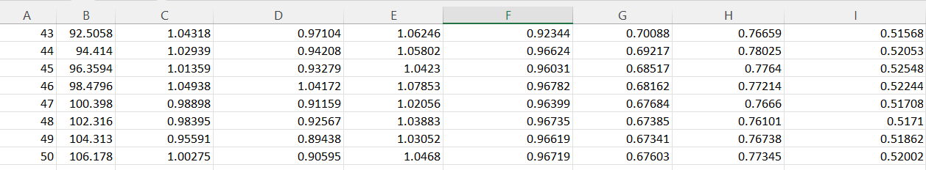
Performance
Precision (B): 0.96719
Recall (B): 0.7060
mAP50 (B): 0.77345

Slide 47
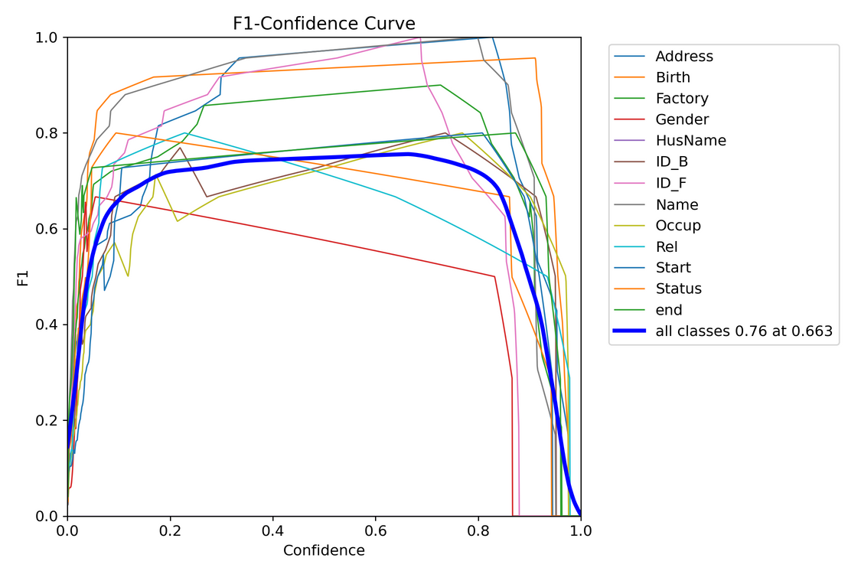
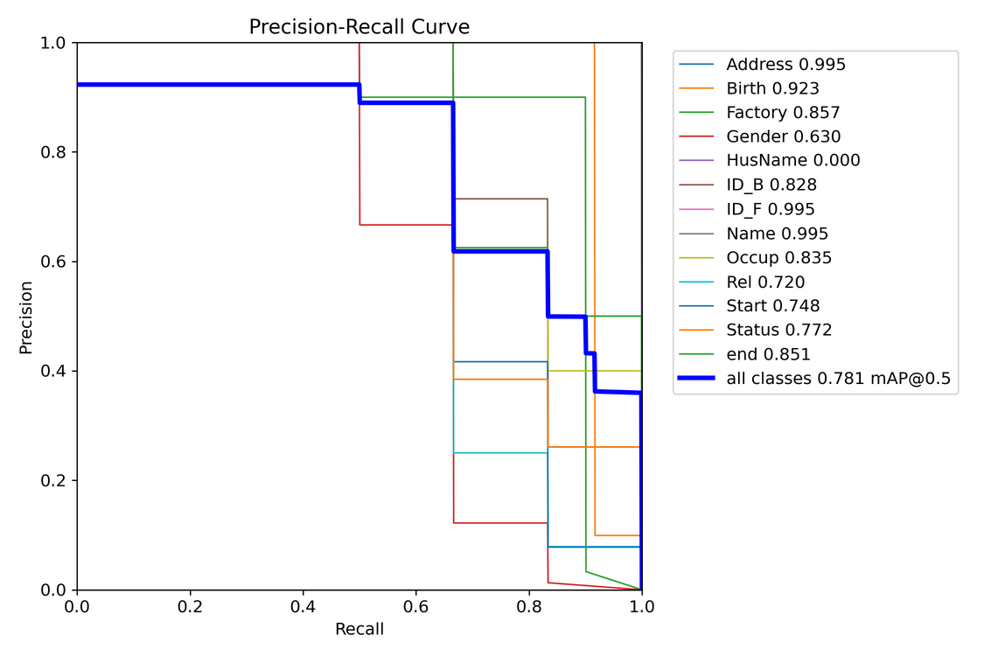
F1-Curve
PR Curve

Slide 48
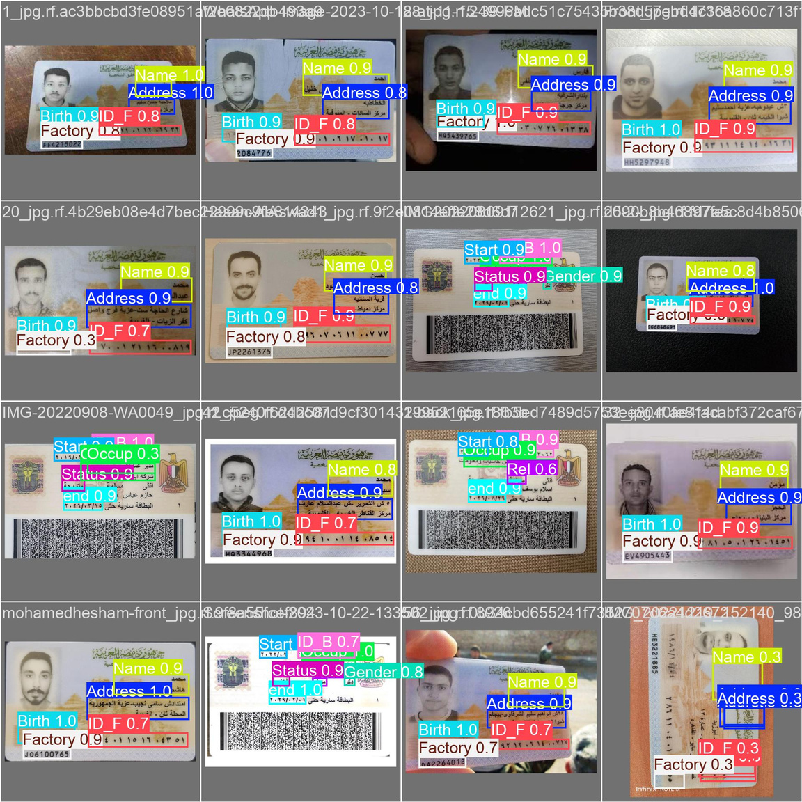
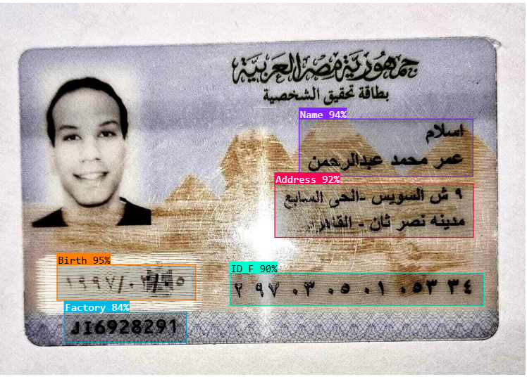
Test Results

Slide 49
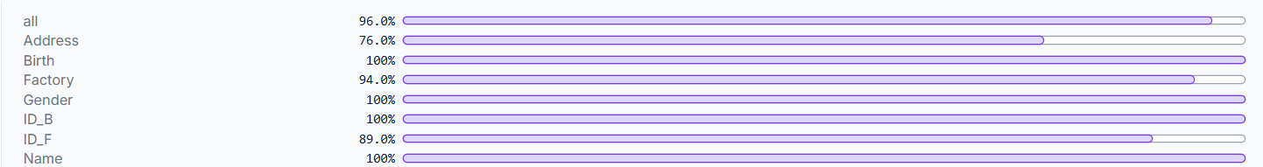
🎯 Top Performing Classes
Notes:
Ready for OCR

Slide 50

ID Extraction Phases
01
02
03
ID detection using YOLO
Field detection using YOLO
Content extraction using OCR
Phase 1
Phase 2

Slide 51
Phase 1 Summary
🔹 YOLO Model 1: ID Detection
This model detects and localizes the National ID card within a larger image, especially useful if the ID is placed on a cluttered background or captured from a camera.
🔹 YOLO Model 2: Field Detection
After cropping the ID, we feed it to a second YOLO model trained to detect individual fields on the card: national ID number, name, date of birth ,gender ..etc.

Slide 52
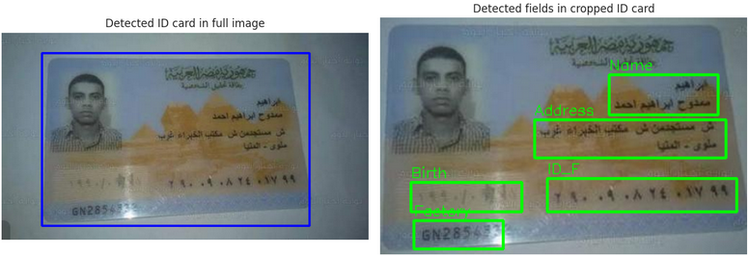
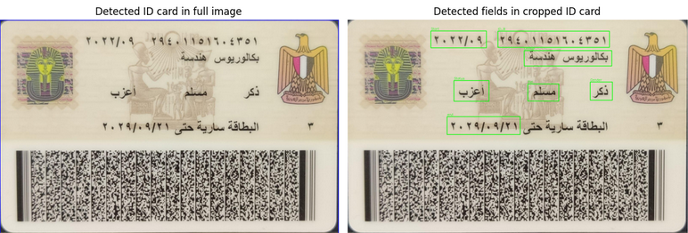
Phase 1 Final Results
This two-step detection helps us isolate only the relevant parts of the ID for further processing
National ID front sample
National ID back sample

Slide 53

READY FOR
PHASE 2

Slide 54
🧾 Why OCR is Needed
To automatically read the text content from the Egyptian National ID provided during voter registration,
so we can extract and verify key information such as:
🆔 National ID Number
🧑‍💼 Full Name
📅 Date of Birth
This ensures the user-provided data matches the official ID, enabling a secure and automated identity verification process.

Slide 55
OCR and Field Extraction
After detecting the National ID and its individual fields using our two-stage YOLO pipeline, we crop each detected field and pass it to our OCR module for text recognition.
We used EasyOCR, a deep learning–based text recognition model that supports both Arabic and English scripts. This was essential for accurately extracting the ID content, especially the Arabic numbers, and converting them into English digits to match the format that will be provided by the user during the voting process.

Slide 56
Why EasyOCR?
✅ Multilingual Support
Supports both Arabic and English, which is essential for Egyptian National IDs.
✅ Deep Learning-Based
Uses CRNN + CTC decoding, providing high accuracy for real-world images with mixed fonts and noisy backgrounds.
✅ No Training Required
Pretrained and ready to use — saved time and effort compared to building a custom OCR from scratch.

Slide 57
Why EasyOCR?
✅ Field-Level Flexibility
Performs well on small cropped fields, which matches our YOLO-based pipeline.
✅ Lightweight and Easy to Integrate
Simple Python API that fits easily into our preprocessing and post-processing pipeline.

Slide 58
OCR Workflow
01
02
03
ID detection using YOLO
Field detection using YOLO
Content extraction using OCR
01
02
03
04
Preprocessing
Apply EasyOCR
model
Post-
Processing
Final Output

Slide 59
Preprocessing for OCR Accuracy
Before feeding the cropped fields into the OCR model, we applied several preprocessing steps to improve accuracy:
Grayscale conversion to simplify the image and focus on text.
Inverse thresholding to enhance contrast between text and background.
Resizing the image to make small text more readable for OCR.
Noise reduction by simplifying the image structure.
These steps significantly improve OCR performance and ensure the extracted data is clean and usable.

Slide 60
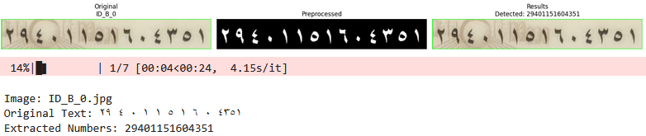
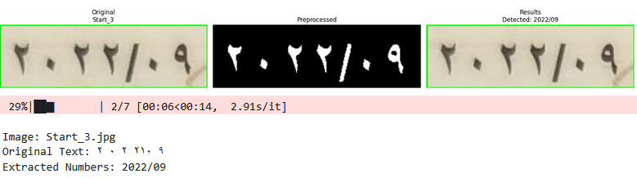
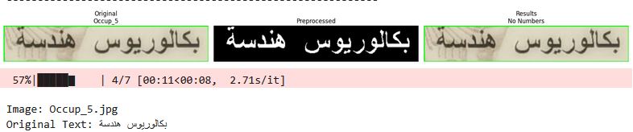
Preprocessing for OCR Accuracy

Slide 61
Post-Processing for OCR Accuracy
We applied custom post-processing techniques to improve text extraction quality:
Converted Arabic digits to English
Extracted clean numeric values (e.g., NID, dates)
Removed unwanted symbols and spaces
Fixed OCR errors like slashes misread as "1"
This approach helps us accurately extract numeric fields for use in our e-voting system.

Slide 62

FINAL
RESULTS

Slide 63
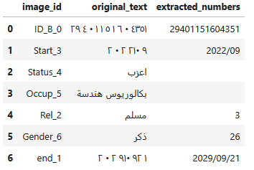
OCR Final Results
This table is generated automatically after running the full pipeline on a batch of ID images.
Each field is detected, cropped, preprocessed, and passed through OCR.
The result is then cleaned and normalized to ensure it’s accurate and consistent then saved as CSV file.

Slide 64
Focused Extraction: Why Only NID?
Our OCR model was initially built to extract all key fields from Egyptian ID cards: Name, Date of Birth, Gender, Job, and the National ID Number (NID).
After testing the full extraction pipeline, we decided to focus solely on the NID for the next stages of development.
The NID is a unique and official identifier used for identity verification and is essential for secure voter linking in the blockchain.
This focus allowed us to improve OCR accuracy, simplify postprocessing, and ensure a cleaner integration with the blockchain voting system.
By targeting only the NID, we optimized both performance and security in the overall e-voting workflow.

Slide 65
07
FAKE ID
DETECTION

Slide 66
ID CARD VERIFICATION MODEL
Purpose:
Detects fake IDs by analyzing images for signs of tampering using AI and forensics techniques (ELA & LBP).
Why It Matters:
Used for identity theft & fraud detection .
Spots what humans miss under time pressure.

Slide 67
PREPROCESSING
we use two forensic techniques:
Error Level Analysis (ELA): shows parts of an image that might have been changed by showing differences in compression quality.
Saves images again at 90% quality.
Compares with the original to find spots that don't match.
Amplifies differences by 15× so edited parts look brighter.
ELA acts like a tool that catches Photoshop edits.

Slide 68
PREPROCESSING
2. Local Binary Patterns (LBP): looks at textures in a image to spot signs of editing.
Analyzes neighborhood pixel relationships.
Encodes texture patterns as numerical features.
Detects changes in text style's or background pattern's.
LBP works as a fingerprint reader but for image textures.

Slide 69
PREPROCESSING
Feature | ELA | LBP
Detects | Digital tampering | Physical tampering
Best for | Edited parts in digital images | Printed/Scan quality issues
strengths | Catches tiny digital edits | Good for paper or scanned id's
Outputs | Heatmap of edits | Texture pattern map

Slide 70
MODEL ARCHITECTURE
Three-Branch Hybrid Network:
Original Image Branch: MobileNetV2,cause it recognizes fine details.
ELA Branch: Processing layer, it finds editing traces.
LBP Branch: Processing layer, it catches physical tampering.
Feature Fusion from all three branches.

Slide 71
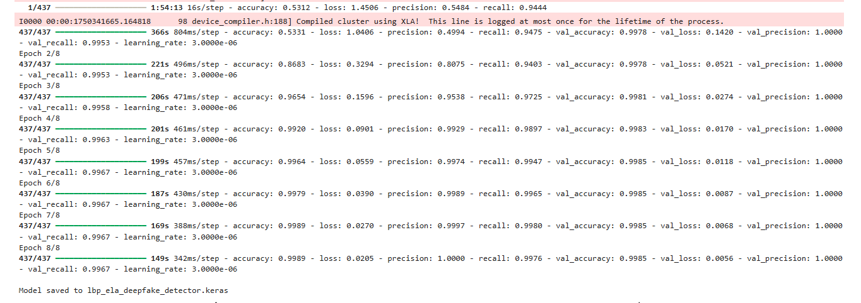
•The model gets accuracy of 99.9% on train and 99.9%on validation

Slide 72
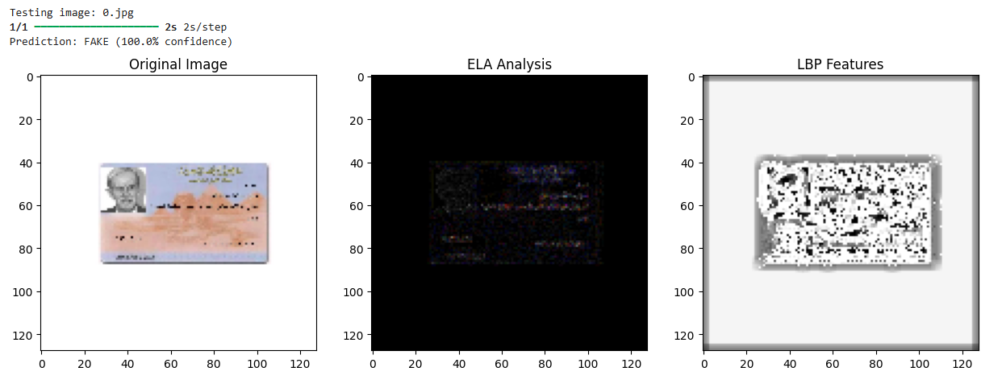
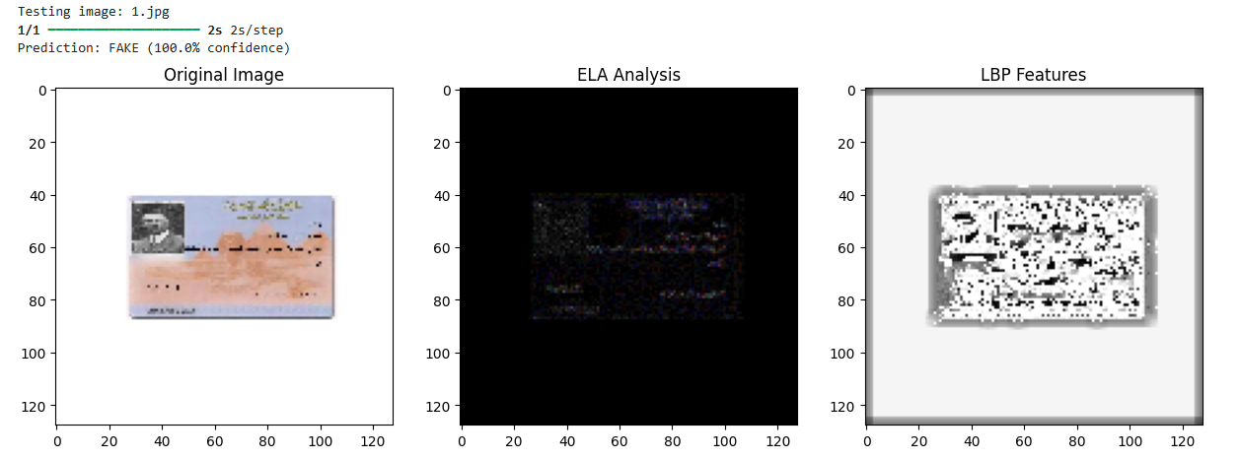
•And here are samples of the test on fake id cards

Slide 73
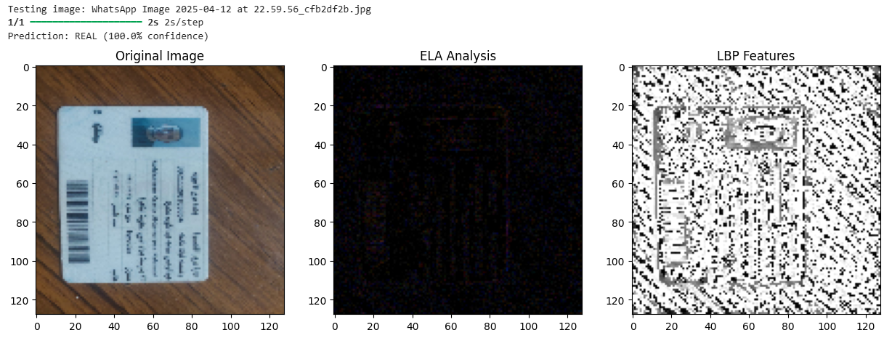
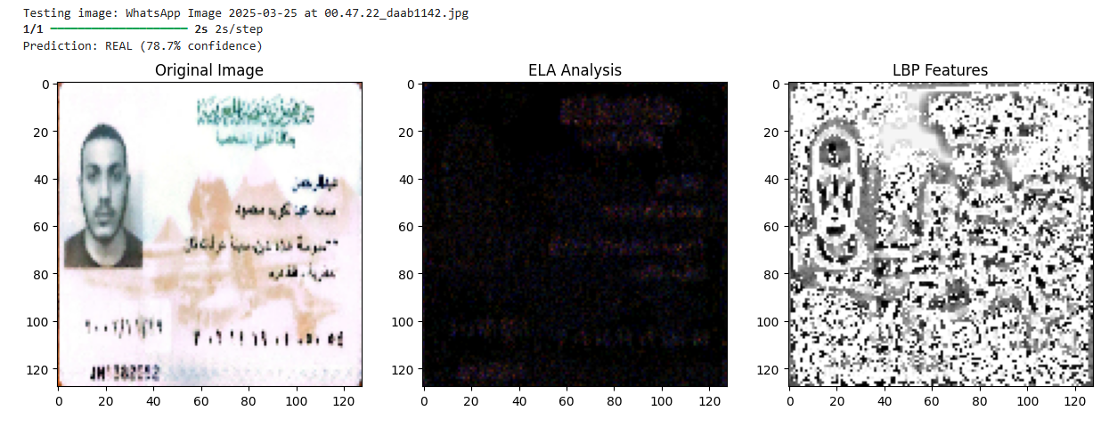
•And here are samples of real id cards

Slide 74
09
BLOCKCHAIN

Slide 75
ZK-SYNC
Layer 1 Security: zkSync inherits the security guarantees of Ethereum Layer 1, meaning the system does not sacrifice any security while benefiting from scalability.
Security and Immutability: zkSync uses zero-knowledge proofs to ensure that all transactions are secure and immutable, meeting the system’s requirement for tamper-proof voting records.
Smart Contract Support: zkSync is compatible with Solidity, enabling seamless development and integration of voting-related smart contracts.

Slide 76
ZK-SYNC
Account Abstraction: zkSync simplifies the user experience by handling transaction fees, signatures, and wallet logic behind the scenes, making blockchain voting accessible to everyone.
Transaction Sponsorship
Scalability: Capable of handling thousands of transactions per second.
Cost-Efficiency: zkSync significantly reduces transaction fees up to 95-98% compared to Ethereum Layer 1, making it suitable for high-volume voting scenarios.

Slide 77
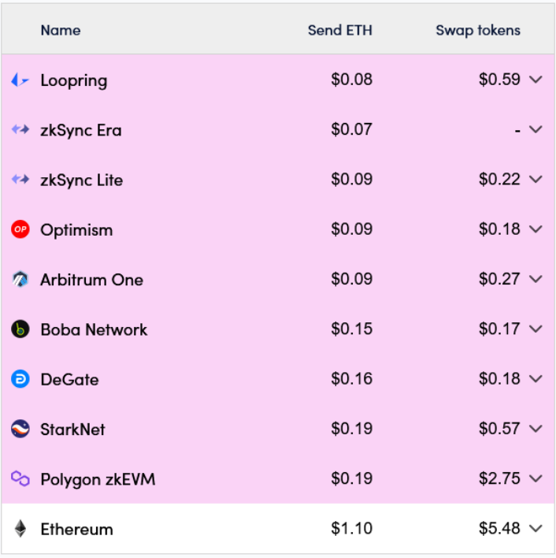
TRANSACTION FEES
zk-Sync
VS
Ethereum Mainnet

Slide 78

TRANSACTION FEES
zk-Sync
VS
Ethereum Mainnet

Slide 79
Implementation
User Registration & Verification
Creating Proposals
Deleting Proposals
Casting Votes
Retracting Votes
Changing Votes

Slide 80
Voter Registration
Voters are verified and registered
Create Proposal
A new voting proposal is created
Cast Vote
Voters cast their votes on a proposal
Tallying
Votes are automatically tallied during the proposal period
Change / Retract Vote
Voters can change or retract their vote

Slide 81
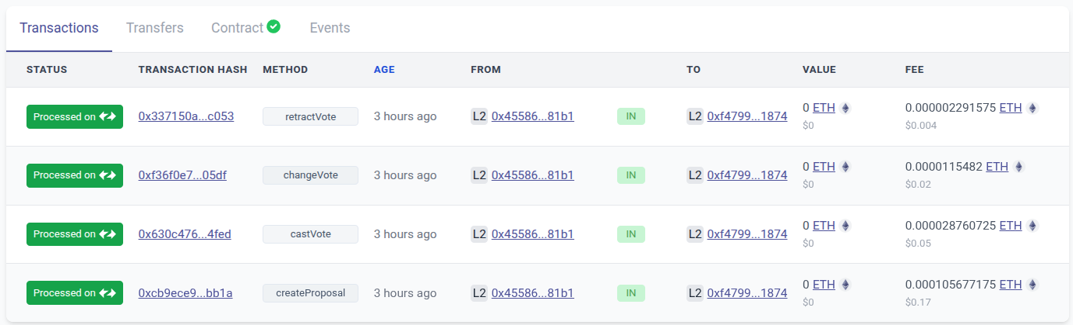
Deployment: zKSync
$ 0.003
$ 0.019
$ 0.048
$ 0.177
Avg cost per Transaction
$ 0.06

Slide 82
10
FRONTEND

Slide 83
DEMO TIME

Slide 84


Slide 85
11
CONCLUSION

Slide 86
PROJECT SUMMARY & IMPACT
Developed a secure, AI-powered e-voting system using blockchain.
Integrated multiple technologies:
🔹 Face Verification 🔹 Object Detection
🔹 Fake ID Detection 🔹 Dynamic Web Interface
🔹 OCR for NID Extraction 🔹 zkSync Blockchain
Ensures:
- Identity Security - Scalability & Accessibility
- Vote Integrity

Slide 87
WHAT WE ACCOMPLISHED
Built a full pipeline from user verification to vote recording.
Successfully extracted and verified National ID Numbers using OCR.
Deployed facial recognition and fake ID detection for double-layered security.
Integrated zkSync blockchain to store votes with immutability and transparency.
Delivered a user-friendly web interface that hides backend complexity.

Slide 88
12
Future Work

Slide 89
FUTURE ENHANCEMENTS
OCR Error Handling
Add a fallback flow to prompt the user to re-upload ID if OCR fails due to blur, lighting, or image quality.
Liveness Detection
Implement blink or head-movement detection to prevent face spoofing using photos or videos.
Offline Voting with Sync
Support secure offline voting with sync once the user reconnects to the internet.

Slide 90
FUTURE EXPANSION
Multi-modal Biometric Verification
Introduce fingerprint or voice recognition for more flexible and secure user verification.
Integration with National Databases
Real-time ID verification via government databases for enhanced accuracy and trust.
Broader Use Cases
Extend the system to digital identity services like e-passport control, subsidy distribution, and more.

Slide 91
TOOLS

Slide 92




TOOLS
ZK-Sync
Solidity
Python
React

Slide 93
REFERENCES

Slide 94
REFERENCES
[1] “VGGFace2: A dataset for recognising faces across pose and age” Qiong Cao, Li Shen, Weidi Xie, Omkar M. Parkhi and Andrew Zisserman Visual Geometry Group, Department of Engineering Science, University of Oxford {qiong,lishen,weidi,omkar,az}@robots.ox.ac.uk
[2] “Siamese Neural Networks for One-shot Image Recognition” Gregory Koch, Richard Zemel , Ruslan Salakhutdinov, Department of Computer Science, University of Toronto. Toronto, Ontario, Canada.
[https://www.cs.cmu.edu/~rsalakhu/papers/oneshot1.pdf]
[3] “FaceNet: A Unified Embedding for Face Recognition and Clustering” Florian Schroff, Dmitry Kalenichenko , James Philbin, Google Inc.
[https://www.cv-foundation.org/openaccess/content_cvpr_2015/papers/Schroff_FaceNet_A_Unified_2015
_CVPR_paper.pdf]
[4] “Learning Face Representation from Scratch” Dong Yi, Zhen Lei, Shengcai Liao and Stan Z. Li
Center for Biometrics and Security Research & National Laboratory of Pattern Recognition Institute of Automation, Chinese Academy of Sciences (CASIA)
[5] “Learning Robust Deep Face Representation” Xiang Wu University of Science and Technology Beijing Beijing, China

Slide 95
REFERENCES
[6]“Voting System Using Blockchain (Face Recognition)” Gaddam Harsha Vardhan, Swapnil Shah, Vanshika Gupta, Rohithreddy.B.C, Tanya Bisht
[6] “E-Voting using Blockchain: Moving Away from the Ballot Paper” Irvine Mutandiwa, Calvin P Mugauri, Maronge Musara
[7] “Blockchain-Based Electronic Voting: A Secure and Transparent Solution” Bruno Miguel Batista Pereira, José Manuel Torres, Pedro Miguel Sobral, Rui Silva Moreira, Christophe Pinto de Almeida Soares,
Ivo Pereira
[8] “Blockchain-Based E-Voting System with Face Recognition” V. Sathya Preiya, V. D. Ambeth Kumar, R. Vijay, Vijay K., N. Kirubakaran
[9] “A Blockchain-based Electronic Voting System: EtherVote” Achilleas Spanos Department of Informatics and Computer Engineering, University of West Attica Athens, Greece,
Ioanna Kantzavelou Department of Informatics and Computer Engineering, University of West Attica
Athens, Greece
[10] “A Privacy-Preserving Blockchain-based E-voting System” Arnab Mukherjee, Souvik Majumdar, Anup Kumar Kolya, Saborni Nandi

Slide 96
THANK YOU VERY MUCH!

Slide 97
11
INTEGRATION

Slide 98
END-TO-END SYSTEM INTEGRATION
Our project integrates multiple AI and blockchain components into one unified e-voting platform:
🔹 Face Verification
🔹 Fake ID Detection
🔹 OCR & Field Detection
🔹 zkSync Blockchain
🔹 Dynamic Web Interface
Each part plays a critical role in securing, verifying and recording the vote.

Slide 99
AI-POWERED IDENTITY VERIFICATION
The user submits a live face capture and ID card image.
Face Verification confirms the user's identity with the registered image.
Fake ID Detection checks the uploaded ID image for signs of forgery (e.g., tampering, edits).
These steps ensure only real and authorized users can access the voting phase.

Slide 100
ID FIELD EXTRACTION WITH OCR
YOLO-based detection models localize the ID card and its fields.
OCR extracts key information, with a focus on the National ID Number (NID).
Preprocessing improves accuracy (grayscale, thresholding, etc.).
Postprocessing (digit conversion, regex) ensures clean and usable output.

Slide 101
SECURE BLOCKCHAIN-BASED VOTING
Once the user is verified, the vote is submitted to the zkSync blockchain.
Smart contracts enforce:
- One vote per user
- Verified identity linkage
- Transparent vote records
zkSync provides high throughput, low cost, and tamper-proof transactions.

Slide 102
DYNAMIC & USER-FRIENDLY WEB APPLICATION
Frontend built for simplicity and accessibility.
Handles:
- Camera capture (face verification)
- ID image upload (OCR & fake ID detection)
- Vote submission and confirmation
Abstracts the blockchain complexity for a smooth user experience.

Slide 103
FULL SYSTEM FLOW
User logs in and uploads ID + live face capture
Fake ID detection validates the authenticity of the ID
Face verification confirms user identity
OCR extracts NID for vote linkage
Vote is submitted securely to the zkSync blockchain
User receives confirmation via the web app

Slide 104
12
FUTURE WORK

Slide 105
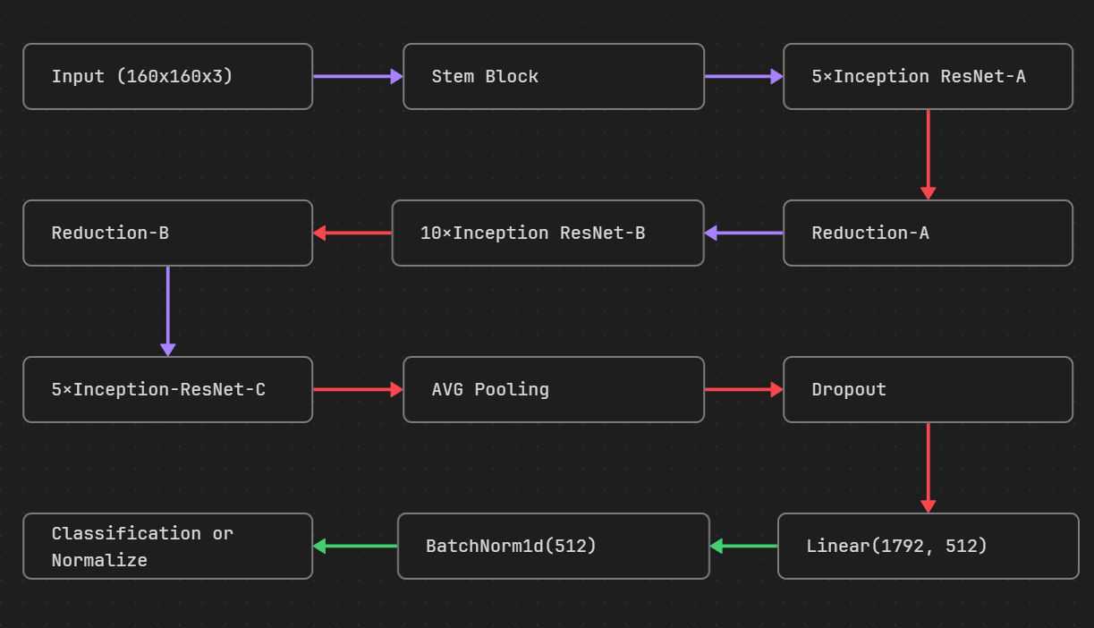
Model: InceptionResnet-V1

Slide 106
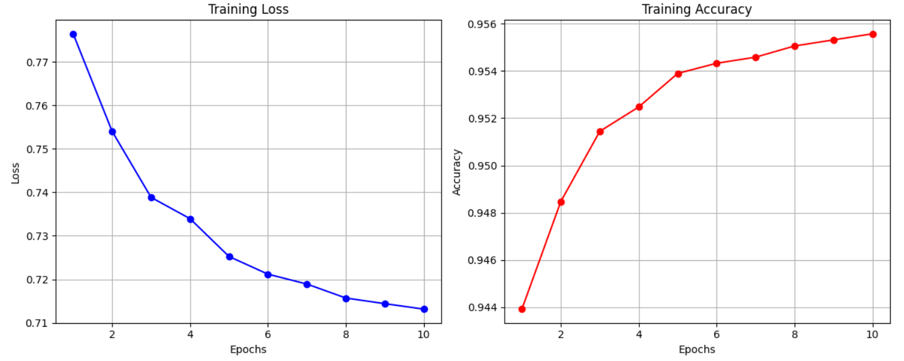
Result

Slide 107
Result
Model | Validation Accuracy | Test Accuracy | Precision | Recall | F1-Score
Resnet50 | 77 | 62.91 | 33.50 | 79.09 | 47.07
Inception Resnet-V1 | 97.09 | 99.28 | 99.63 | 98.93 | 99.28

Slide 108
11
TIME PLAN

Slide 109
October November December January February March April May
Survey
Dataset Preparation
Model Selection
Model Building
Smart Contract Development
Frontend Development
Smart Contract Auditing
System Integration
System Testing
Documentation

Slide 110
12
NEXT PHASE

Slide 111
NEXT PHASE
Models
Improve Performance
Reduce Complexity
Change some Preprocessing Technique
BlockChain
Automatic change in the Proposal Status
Active, Pending, Closed
Determining the most voted Option.
Making the Contract Upgradable.
Encryption / Decryption Module

Slide 112
NEXT PHASE
Frontend
Voter History Page
Active Votes Page
System
Integration all The System Component
Test The System

Slide 113





Facial Recognition
Verified User
Frontend
Enterface
User
Feature
Extractions
AI
Verification
Blockchain
Encryption / Decryption Module

Slide 114

Facial Recognition
User
Verified User
Frontend
Enterface
Feature
Extraction
AI
Verification
ID
Data Extraction
AI
Verification
Blockchain
Encryption / Decryption Module
Feature
Extraction

Slide 115
ID VERIFICATION
Why Do We Need ID Verification?
🧾 Problem:
In digital voting systems, anyone can enter a national ID number manually.
But…
➡️ How do we know if this number really matches the person's ID?

Slide 116
ID VERIFICATION
🎯 Our Solution:
We detect and extract the national ID number directly from the uploaded ID image (using our YOLOv8 models and OCR), then:
🟡 Compare it with the manually entered ID number

Slide 117


Slide 118
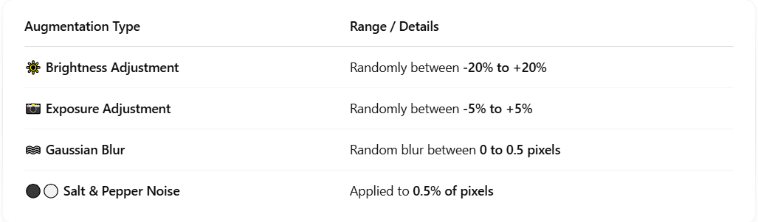
Pre Processing & Augmentation

Slide 119
Pre Processing
01
02
ID Detetction DataSet
(4200 image )
Fileds Detection DataSet
(150 image)

Slide 120
Survey Conclusion
It may seem that Ethereum is the best blockchain for our goal, yet it isn't the most optimal choice!
Ethereum limitations:
Limited to 15-30 TPS, causing bottleneck during high demand.
Slower transaction processing with 10–15 seconds per block.
High and unpredictable transaction fees.
“Ethereum rough patch”:
On May 1, 2022, Ethereum's average transaction fee reached its all-time high, approximately $196.64 per transaction

Slide 121
Blockchain
zk-Sync
A Layer 2 Ethereum scaling solution

Slide 122
ZK-SYNC
Security and Immutability: zkSync uses zero-knowledge proofs to ensure that all transactions are secure and immutable, meeting the system’s requirement for tamper-proof voting records.
Layer 1 Security: zkSync inherits the security guarantees of Ethereum Layer 1, meaning the system does not sacrifice any security while benefiting from scalability.
Smart Contract Support: zkSync is compatible with Solidity, enabling seamless development and integration of voting-related smart contracts.

Slide 123
ZK-SYNC
Scalability: Capable of handling thousands of transactions per second.
Cost-Efficiency: zkSync significantly reduces transaction fees up to 95-98% compared to Ethereum Layer 1, making it suitable for high-volume voting scenarios.

Slide 124
ZK-SYNC
Scalability: Capable of handling thousands of transactions per second.
Cost-Efficiency: zkSync significantly reduces transaction fees up to 95-98% compared to Ethereum Layer 1, making it suitable for high-volume voting scenarios.

Slide 125
SMART CONTRACTS
Smart contracts written in Solidity will handle the core voting logic, including vote casting, encryption, and result aggregation.

Slide 126
SMART CONTRACTS
Transparency: All voting operations are recorded on the blockchain, ensuring that the process is auditable and verifiable by all stakeholders.
Automation: Smart contracts eliminate the need for manual intervention by automating processes such as vote counting and validation.
Anonymity: The system will encrypt votes before storing them, ensuring that individual voter preferences remain private.
Tamper-Proof: Once deployed, the smart contract logic cannot be altered, ensuring trust in the system’s integrity.

Slide 127

UPGRADABLE SMART CONTRACTS
Implementation
Contract
0x6D1
0x5F6
User
Proxy
Contract

Slide 128

UPGRADABLE SMART CONTRACTS
0x6D1
0x5F6
User
Implementation
Contract
Proxy
Contract
0x2D5

Slide 129
UPGRADABLE SMART CONTRACTS
0x6D1
0x5F6
User
Proxy
Contract
0x2D5
Implementation
Contract
0xC4B

Slide 130

AGENDA
01
02
03
04
Problem Definition
Motivation
Scope
Objective
05
06
07
08
Identification of proposed methdologies
System
Architcure
Time Plan
Survey

Slide 131
Facial Recognition Survey
Paper | Dataset | Preprocessing | Feature Extraction | Models | Results Achieved
[1] Profile to Frontal Face Recognition in the Wild Using Coupled Conditional GAN | VGGFace2 | Images cropped and normalized; pose-specific templates created | ResNet-18 encoder with U-Net decoder | Coupled Conditional GAN (cpGAN) | Improved GAR at FAR of 0.01 to 93.8%
[2] VGGFace2: A Dataset for Recognizing Faces Across Pose and Age | VGGFace2 | Image cropping, resizing, normalization, and face alignment | ResNet-50 pre-trained on ImageNet for feature embeddings | CNN-based models such as ResNet-50, SENet | State-of-the-art performance on IJB-A, IJB-B, and IJB-C benchmarks

Slide 132
Paper | Dataset | Preprocessing | Feature Extraction | Models | Results Achieved
[3] Learning Face Representation from Scratch by Dong Yi et al. | CASIA-WebFace | Face alignment, normalization, and cropping | Deep feature extraction using CNNs | CNN | 97.3% accuracy on LFW benchmark
[4] Learning Robust Deep Face Representation by Xiang Wu | CASIA-WebFace | Face alignment, normalization | Feature embeddings using CNN | CNN-based model with robust representation learning | 98.4% accuracy on LFW benchmark
[5] Voting System Using Blockchain (Face Recognition) – IRJET | Custom voter face dataset | Image resizing, normalization, and face alignment | Facial embeddings using CNN (e.g., FaceNet) | Convolutional Neural Networks (CNN) | High authentication accuracy

Slide 133
Blockchain Survey
Paper | Publication Year | Blockchain | Smart Contract Language | Blockchain Layer | Limitations
[6] E-Voting using Blockchain: Moving Away from the Ballot Paper | 2023 | Ethereum | Solidity | Layer 1 | High computational cost, scalability concerns
[7] Blockchain-Based Electronic Voting: A Secure and Transparent Solution | 2023 | Ethereum | Solidity | Layer 1 | High computational cost, scalability concerns
[8] Blockchain-Based E-Voting System with Face Recognition | 2023 | Ethereum | Solidity | Layer 1 | High computational cost, scalability concerns
[9] A Blockchain-based Electronic Voting System: EtherVote | 2023 | Ethereum | Solidity | Layer 1 | High computational cost, scalability concerns
[10] A Privacy-Preserving Blockchain-based E-voting System | 2023 | Ethereum | Solidity | Layer 1 | High computational cost, scalability concerns

Slide 134


TRANSACTION FEES
zk-Sync
VS
Ethereum Mainnet

Slide 135
TRANSACTION FEES
zk-Sync
VS
Ethereum Mainnet

Slide 136
Future Work
Automatic change in the Proposal Status
Active, Pending, Closed
Determining the most voted Option.
Making the Contract Upgradable.
Encryption / Decryption Module

Slide 137

Facial Recognition
User
Verified User
Frontend
Enterface
Feature
Extraction
AI
Verification
ID
Data Extraction
AI
Verification
Blockchain
Encryption / Decryption Module
Feature
Extraction

